Slide 1
ENGR 5345
Review of Probability & Random Variables

Slide 2
Random Variables
Assign each event outcome in S to a real number (random variable), X.
Ex: heads ⇒ X=12
tails ⇒ X=47
If the event outcome is numerical, equating the outcome to X is often convenient.

Slide 3
Random Variables (cont)
Each RV, X, has a probability equal to the event to which it is assigned.
The Cumulative Distribution Function (CDF)

Slide 4
CDF Properties
1. Since the CDF is a probability,
2. The CDF is monotonically increasing (a.k.a. nondecreasing)
Note: ,
1
x

Slide 5
CDF Properties (cont)
3. The CDF is continuous from the right
1
x

Slide 6
Probabilities from CDF’s
p
x
a
b

Slide 7
Probability Density Function

Slide 8
PDF Properties
f_{X}(x)
1 .
2.
3.
x
A

Slide 9
Histograms as PDF’s
A histogram normalized to unit area is an empirical pdf.
N = # data points
h_{N}(x)
x
Δ

Slide 10
Conditional CDF’s

Slide 11
Conditional pdf’s

Slide 12
Discrete RV’s
Discrete RV’s have only integer outputs.
impulse function (Dirac delta)
Probability mass function (pmf)
Beware of deltas on the edge of integration when evaluating

Slide 13
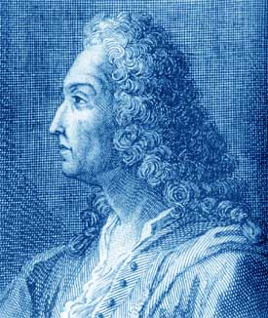
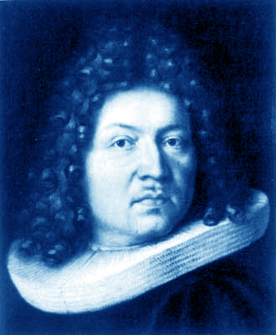
Common RV PDF’s
Bernoulli, p = probability of success
f_{X}(x)
q=1-p
p
Jacob Bernoulli
Born: 27 Dec 1654 in Basel, Switzerland Died: 16 Aug 1705 in Basel, Switzerland
0
1
x
Pictures in this presentation from http://www-groups.dcs.st-and.ac.uk/~history/index.html

Slide 14
Common RV PDF’s
Binomial (n repeated Bernoulli trials)
= binomial coefficient
(Pascal’s triangle)

Slide 15
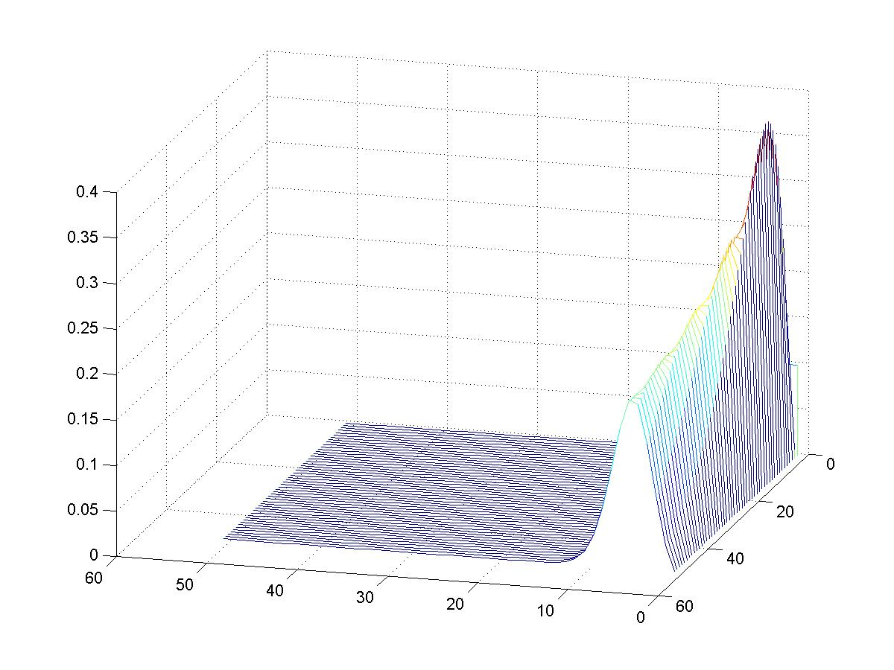
Binomial RV (p=0.1) vs. n
n
k

Slide 16
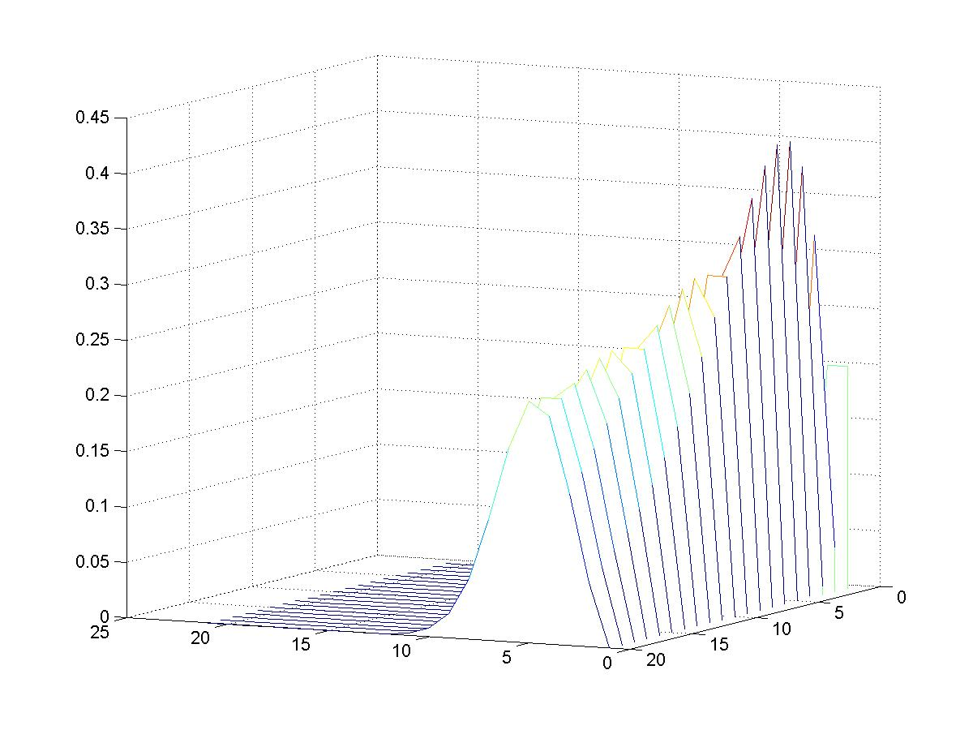
Binomial RV (p=0.2) vs. n
k
n

Slide 17
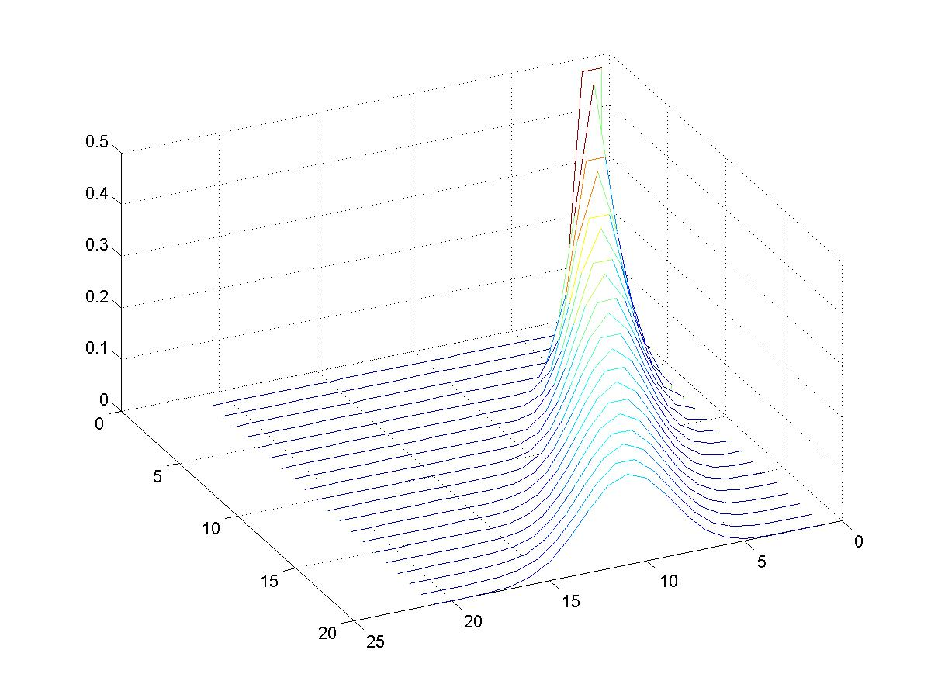
Binomial RV (p=0.5) vs. n
n
k

Slide 18
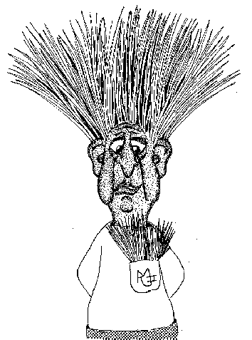
Geometric RV
Repeat a Bernoulli trial until a success occurs.
The number of trials is a geometric random variable.

Slide 19
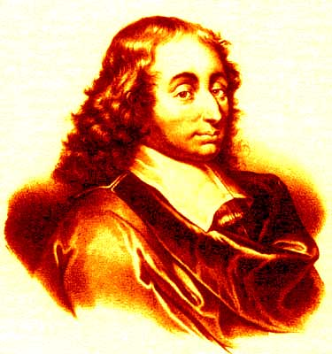
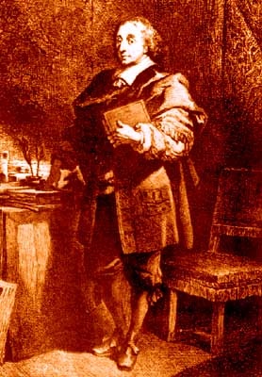
Negative Binomial (Pascal) RV
Repeat Bernoulli trials. Let X=number of trials to achieve r^{th} success.
Blaise Pascal
Born: 19 June 1623 in Clermont France Died: 19 Aug 1662 in Paris, France

Slide 20
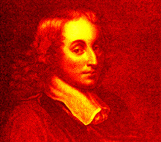
PASCAL: a high level programming language designed by Niklaus Wirth in 1974 as a teaching language for computer scientists.
Pascal’s Law: the pressure in a fluid is transmitted equally to all distances and in all directions.
PASCAL: A unit of pressure. 1 bar equals 100,000 Pascal
Pascal’s triangle.
Pascal
Blaise Pascal
(1623-62)
Blaise Pascal (1623-62)
Blaise Pascal (1623-62)

Slide 21
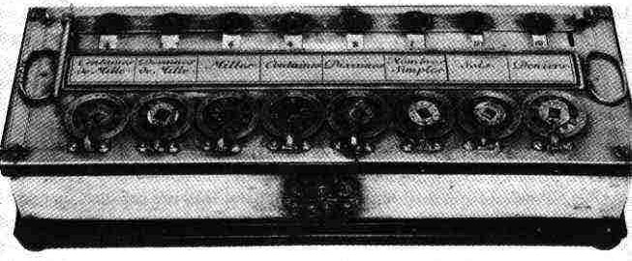
Pascal: Computer Engineer
Pascal
In 1642, Pascal began to create a machine that would be similar to an everyday calculator to help his father with his accounting job.
He finished the final model in 1645.
He presented one to Queen Christina of Sweden and he was allowed a monopoly over it by royal decree.
http://www-groups.dcs.st-and.ac.uk/~history/index.html

Slide 22
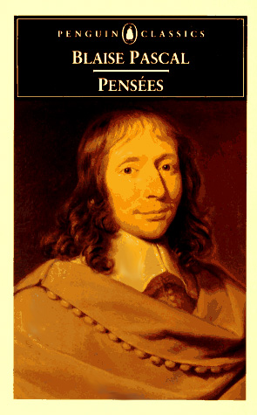
Pascal’s Wager…
Pascal's Wager
Pascal, a Christian theist still studied in philosophy and religion, communicated theological concepts wrapped in the interest of his contemporaries’ interest in probability and gambling.
"Let us examine this point and say, "God is, or He is not." ... What will you wager? ... Let us weigh the gain and loss of wagering that God is ... there is here an infinity of an infinitely happy life to gain, a chance of gain against a finite number of chances of loss, and what you stake is finite ... every player stakes a certainty to gain an uncertainty, and yet he stakes a finite certainty to gain a finite uncertainty, without transgressing against reason ... the uncertainty of the gain is proportioned to the certainty of the stake according to the proportion of the chances of gain and loss. ... And so our proposition is of infinite force, when there is the finite to stake in a game where there are equal risks of gain and loss, and the infinite to gain.”
Article 223 of Pensees

Slide 23
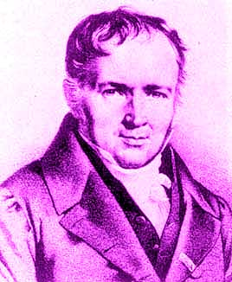
Poisson RV
Number of random points on a line segment.
Approximation of binomial random variable.
Siméon Denis Poisson
Born: 21 June 1781 in Pithiviers, France Died: 25 April 1840 in Sceaux , France

Slide 24
Continuous Uniform RV
Describes random angle with a=0 and b=2π
Rounding & truncation errors

Slide 25
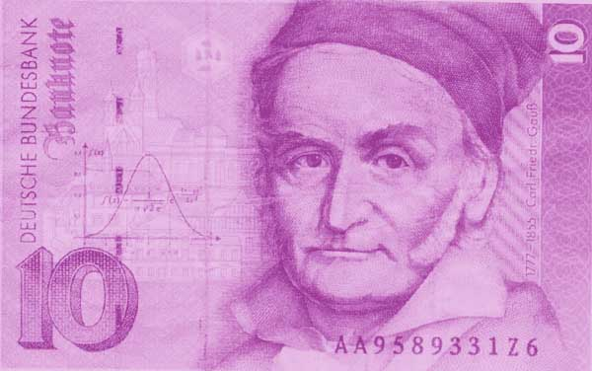
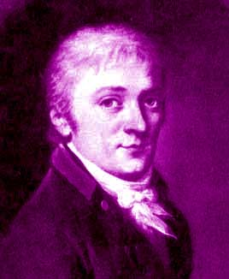
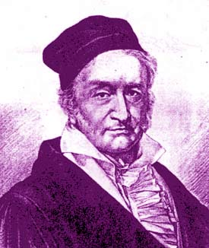
Gaussian (normal) RV
Limiting distribution in Central Limit Theorem
Johann Carl Friedrich Gauss
Born: 30 April 1777 in Brunswick, Duchy of Brunswick (Germany) Died: 23 Feb 1855 in Göttingen, Hanover (Germany)
1803

Slide 26
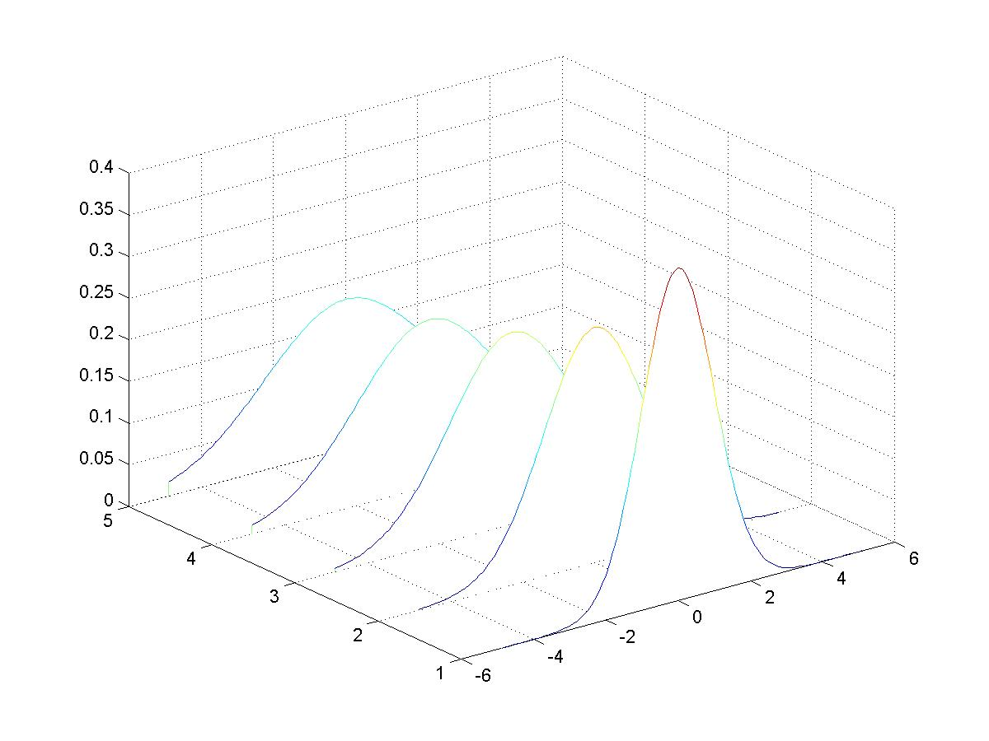
Gaussian (normal) RV
f_{X}(x)
σ²
x

Slide 27
Gaussian (normal) CDF

Slide 28
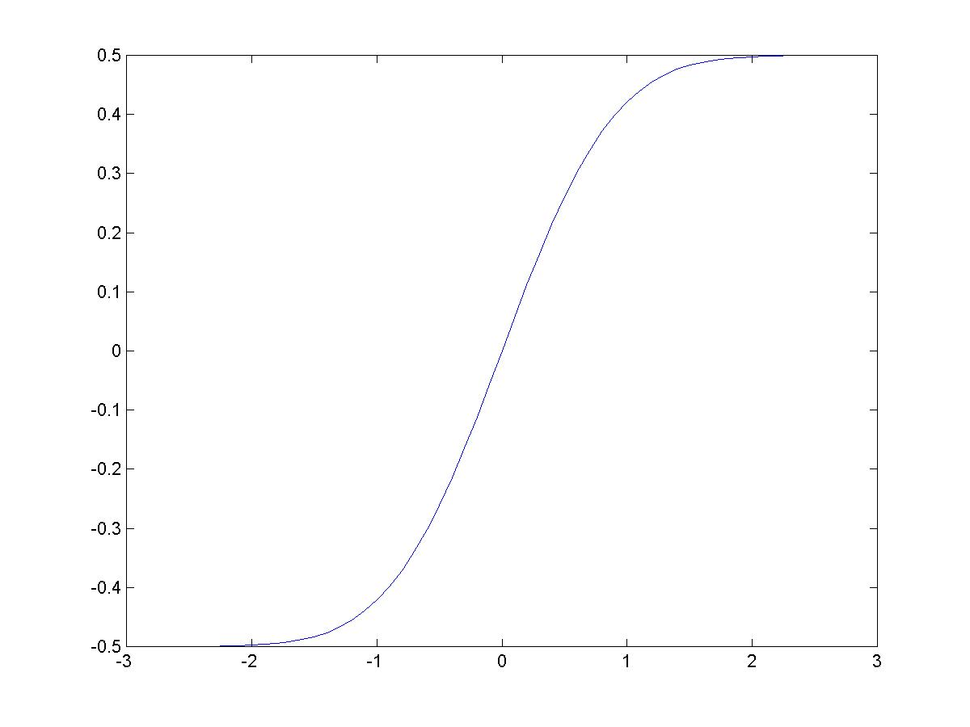
Gaussian Error Function

Slide 29
Matlab erf
ERF Error function.
Y = ERF(X) is the error function for each element of X. X must be real. The error function is defined as:
erf(x) = 2/sqrt(pi) * integral from 0 to x of exp(-t^2) dt.
Conversion Formula?

Slide 30
Exponential RV
μ(x)=unit step
Commonly used model in reliability for constant failure rates.

Slide 31
The Ageless Exponential RV
1. Let X be how long you live after you’re born and
3. You’ve lived y years.
2. Thus:
4. Good as NEW!

Slide 32
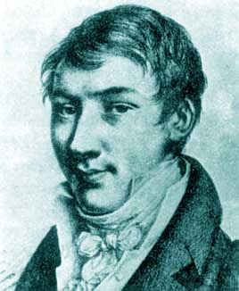
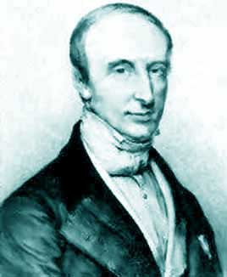
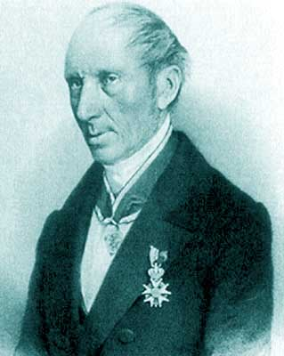
Cauchy RV
“Loose Cannon” RV
Ratio of two Gaussians is Cauchy
Displays strange properties - undefined mean and ∞ second moment.
Augustin Louis Cauchy
Born: 21 Aug 1789 in Paris, France Died: 23 May 1857 in Sceaux, France
“I AM A CHRISTIAN, THAT IS TO SAY, I BELIEVE IN THE DIVINITY OF JESUS CHRIST”

Slide 33
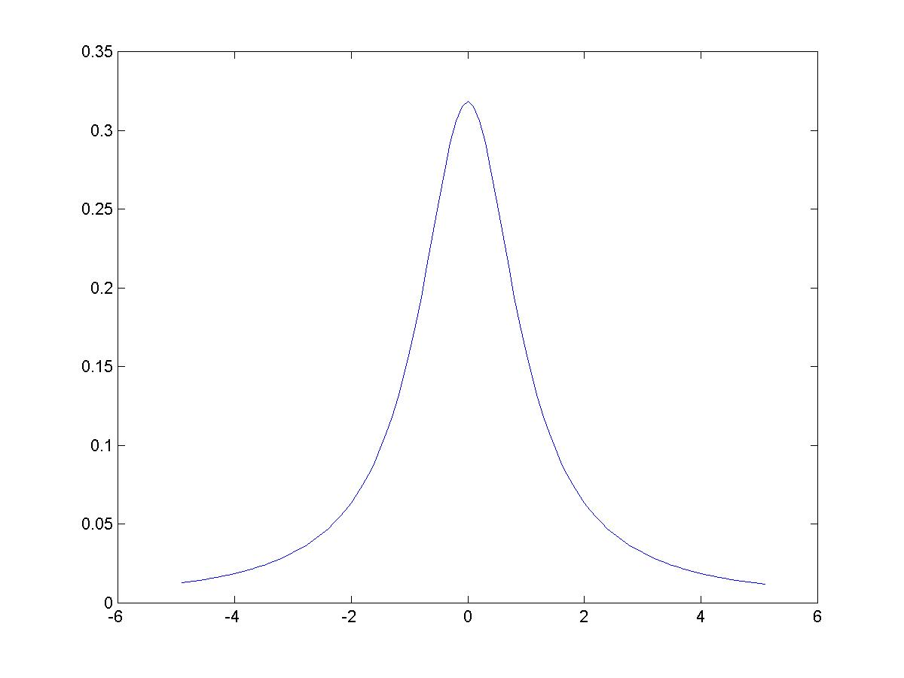
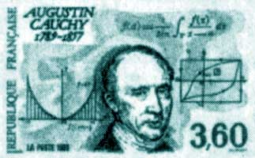
Cauchy RV

Slide 34
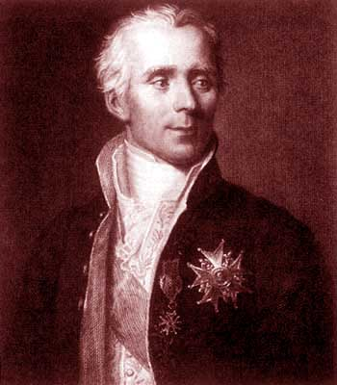
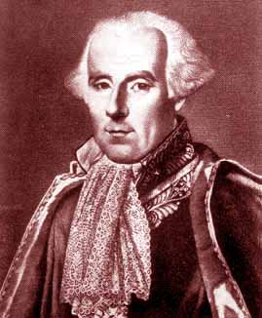
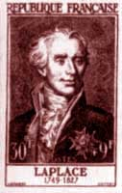
Laplace RV
Pierre-Simon Laplace
Born: 23 March 1749 in Beaumont-en-Auge, Normandy, France Died: 5 March 1827 in Paris, France

Slide 35
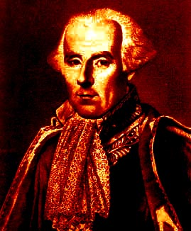
Pierre Simon Laplace (1749-1827).
Namesakes:
Laplace transform
Laplace Noise
Laplace helped to establish the metric system.
Laplacian Operator
Napoleon appointed Laplace Minister of the Interior but removed him from office after only six weeks “because he brought the spirit of the infinitely small into the government.”

Slide 36
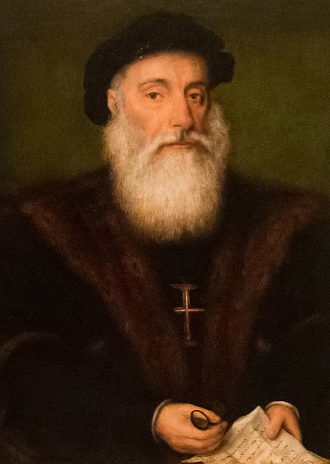
Gamma RV
Vasco da Gama
Has absolutely nothing to due with the Gamma RV
Gamma Function
Erlang RV: Gamma for a=n

Slide 37
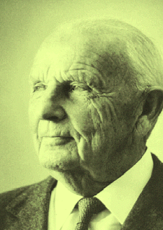
Other RV’s
Weibull
χ2 (chi-squared)
Wallodi Weibull 1887-1979

Slide 38
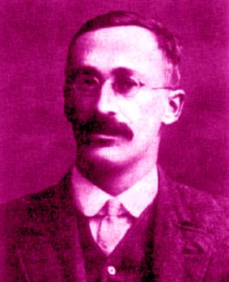
Other RV’s
F
Student’s t
William Sealey Gosset
a.k.a. Student t
Born: 13 June 1876 in Canterbury, England Died: 16 Oct 1937 in Beaconsfield, England

Slide 39
Other RV’s
Rice
Raleigh
Pareto

Slide 40
Mixed Random Variables
Part Continuous – Part Discrete.
Example: A traffic light is red three minutes, then green two. You come on this traffic light. Let T = the time you need to wait at the light. T is a mixed random variable.

Slide 41
Traffic Light
1
1 2 3 t

